Slide 1


Slide 2




Slide 3



MULTITHREADING
IN
JAVA

Slide 4
THREAD PRIORITY
Each thread have a priority
Priorities are represented by a number between 1 and 10
In most cases, thread schedular schedules the threads according to their priority (known as preemptive scheduling)

Slide 5
3 CONSTANTS DEFINED IN THREAD CLASS
public static int MIN PRIORITY
public static int NORM PRIORITY
public static int MAX PRIORITY
Default priority of a thread is 5 (NORM PRIORITY)
The value of MIN PRIORITY is 1 and the value of MAX PRIORITY is 10

Slide 6
LOGIC
class priority extends Thread { public void run() { System.out.println("running thread name is:" + Thread.currentThread().getName()); System.out.println("running thread priority is:" + Thread.currentThread().getPriority()); } | public static void main(String args[]) { TestMultiPriority1 m1 = new TestMultiPriority1(); TestMultiPriority1 m2 = new TestMultiPriority1(); m1.setPriority(Thread.MIN_PRIORITY); m2.setPriority(Thread.MAX_PRIORITY); m1.start(); m2.start(); } }
Notes:
Output:running thread name is:Thread-0
running thread priority is:10
running thread name is:Thread-1
running thread priority is:1

Slide 7
JAVA THREAD POOL
One common type of thread pool is the fixed thread pool
This type of pool always has a specified number of threads running
if a thread is somehow terminated while it is still in use, it is automatically replaced with a new thread

Slide 8
NOTE
Tasks are submitted to a thread pool via an internal queue called the Blocking Queue
If there are more tasks than the number of active threads, they are inserted into the blocking queue for waiting until any thread becomes available
If the blocking queue is full than new tasks are rejected

Slide 9
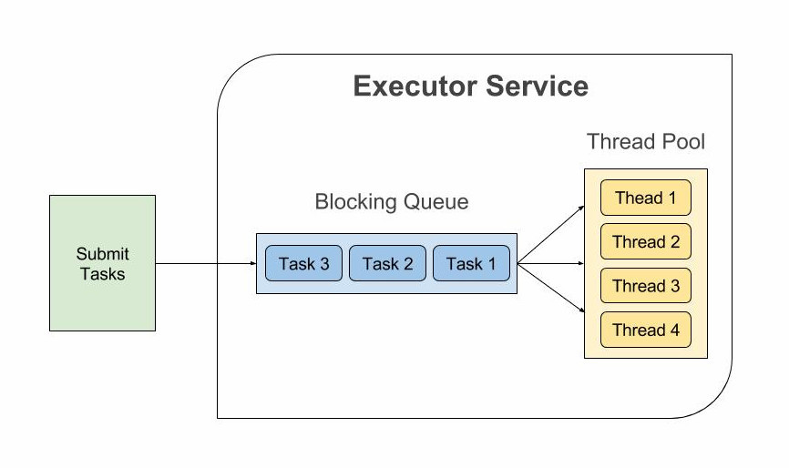
HIERARCHY

Slide 10
LOGIC
import java.util.concurrent.Executors; import java.util.concurrent.ScheduledExecutorService; import java.util.concurrent.TimeUnit; public class ScheduledExecutorsExample { public static void main(String[] args) { ScheduledExecutorService scheduledExecutorService = Executors.newScheduledThreadPool(1); Runnable task = () - > { System.out.println("Executing Task At " + System.nanoTime()); }; | System.out.println("Submitting task at " + System.nanoTime() + " to be executed after 5 seconds."); scheduledExecutorService.schedule(task, 5, TimeUnit.SECONDS); scheduledExecutorService.shutdown(); } }
Notes:
# Output Submitting task at 2909896838099 to be executed after 5 seconds.
Executing Task At 2914898174612

Slide 11
THREAD GROUP
Java provides a convenient way to group multiple threads in a single object
In such way, we can suspend, resume or interrupt group of threads by a single method call
Java thread group is implemented by java.lang.ThreadGroup class
A ThreadGroup represents a set of threads
A thread group can also include the other thread group

Slide 12
CONSTRUCTORS OF THREAD GROUP
CONSTRUCTORS | DESCRIPTION
ThreadGroup(String name) | creates a thread group with given name
ThreadGroup(ThreadGroup parent, String name) | creates a thread group with given parent group and name

Slide 13
LOGIC
public class ThreadGroupDemo implements Runnable { public void run() { System.out.println(Thread.currentThread().getName()); } public static void main(String[] args) { ThreadGroupDemo runnable = new ThreadGroupDemo(); ThreadGroup tg1 = new ThreadGroup("Parent ThreadGroup"); Thread t1 = new Thread(tg1, runnable, "one"); t1.start(); | Thread t2 = new Thread(tg1, runnable, "two"); t2.start(); Thread t3 = new Thread(tg1, runnable, "three"); t3.start(); System.out.println("Thread Group Name: " + tg1.getName()); tg1.list(); } }
Notes:
one
Two
three
Thread Group Name: Parent ThreadGroup
java.lang.ThreadGroup[name=Parent ThreadGroup,maxpri=10]
Thread[one,5,Parent ThreadGroup]
Thread[two,5,Parent ThreadGroup]
Thread[three,5,Parent ThreadGroup]

Slide 14

THANK YOU

